Slide 1
Hey
PROBATION PROJECT
Thanh VO – Hung LE Hey Project – hey.vn

Slide 2
Welcome to Our Presentation
Let’s Begin Now!
The presentation will happen in about 15minutes, which we will give you a brief introduction about HEY project along with some demonstration.
A note that, in this presentation we are using images from the gallery of Sài Gòn có mưa, a creative project about Saigon. You can find out more detail at: https://www.facebook.com/Saigoncomua/

Slide 3
Table of Contents
Introduction
What we have to do
The Team
Who we are
Project Architecture
How we design HEY
Demonstration
Live demo of HEY
Testing
Unit and Performance Testing
Question and Answer
Keep it touch!

Slide 4


1
INTRODUCTION

Slide 5

What is HEY?
HELLO!
This is the probation project at VNG. In this project, we will use React JS, Java Vert.x with Redis to simulate a simple chat application.

Slide 6
What we have to deliver?
Main functions
The project will have following functions:
Sign In
Sign Up
Chat with Other Person in friend list
Chat in group
Add new friend
View Online/Offline friend along with their status
Set Status
Receive notification about Online/Offline friend in friend list

Slide 7
What Technology Stack we used?
Short introduction about the stack
for client side development
ReactJS and Redux
for UI/UX design
Ant.design
for develop the API server
Java Vert.x
for messanging and instant notification
Websocket
as database
Redis

Slide 8


2
The Team

Slide 9

Thanh VO
A normal Person as Developer
1990
Saigonese
Left-handed

Slide 10
Hung LE
Another normal Person as Developer
1990
Right-handed

Slide 11
Our Timeline
How HEY being developed
1st week
3rd week
Final
Received the project
Continue fighting
The day
Start to study the technology stack
Document Work
Design Front End & Back End Framework
Continue to implement
Perform load test and optimize the application
YOLO!
Begin to Develop
Wrapped Everything Up
Implement case by case, function by function
Dockerize application
Finish document
Prepare for the battle
2nd week
4th week

Slide 12


3
HEY ARCHITECTURE

Slide 13


Hey FrontEnd
Hey BackEnd
Hey Redis
Using ReactJs + Redux for state management
Ant.Design for UI/UX Design with modification
Some open source UI lib
Vert.x core
Vert.x web
Vert.x Redis
Vert.x Unit
As database

Slide 14
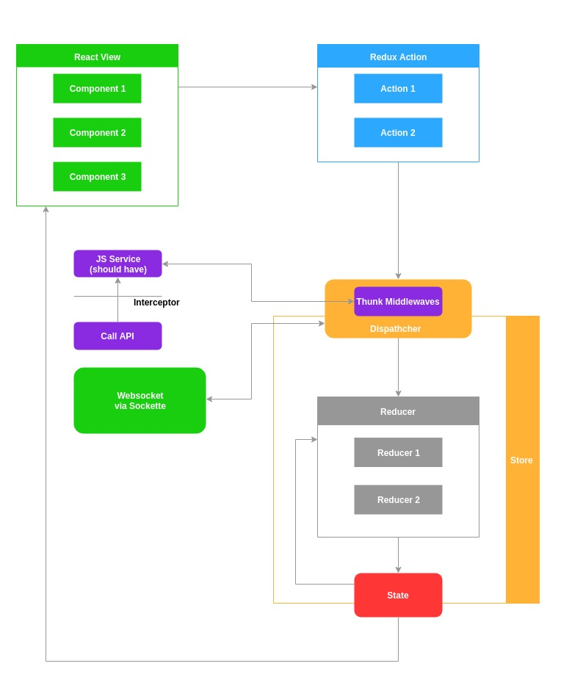
Hey Frontend

Slide 15
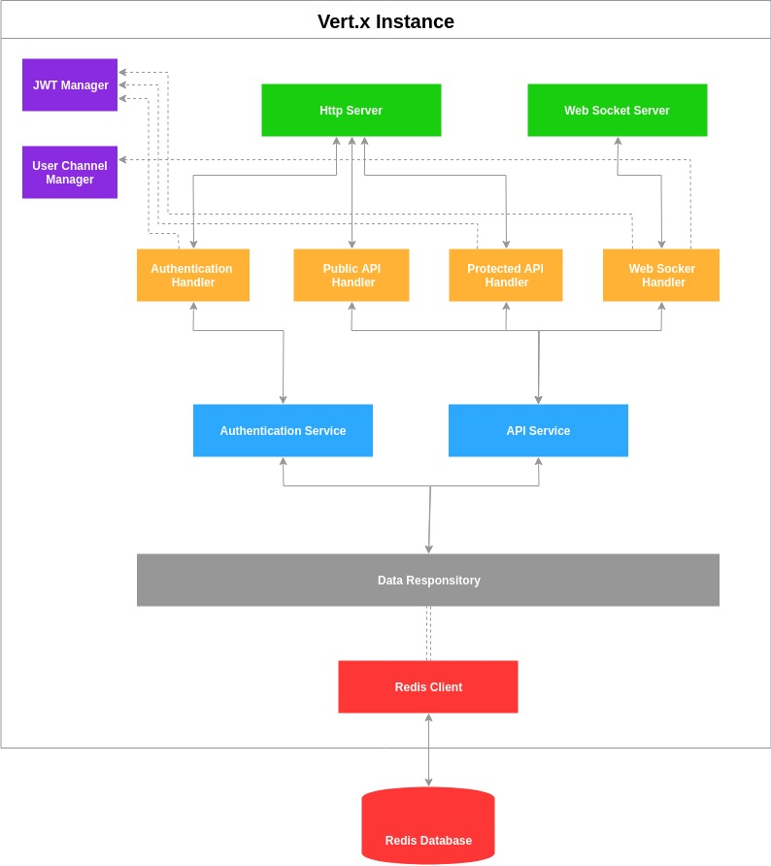
Hey BackEnd

Slide 16
Hey Redis – Data Specifications
How data being described in Redis
Key | Value | Type
user:{user_name} | user_id, hashed_password | Hash Map
user_full:{user_id} | user_name, full_name | Hash Map
user_status:{user_id} | status | String
friend:list:{user_id}:{user_id} | user_id1:full_name, user_id2:full_name | Hash Map
chat:list:{session_id}:{user_id}:{user_id}:… | user_id1:full_name, user_id2:full_name, updated_date, last_message | Hash Map
chat:message:{session_id}:{created_date} | user_id:full_name, message, created_date | Hash Map
unseen:{user_id}:{session_id} | count | Number

Slide 17
Dockerize HEY
Using Docker
Manually
Docker Compose
Shell Script

Slide 18
Manually Dockerize
Using Docker
Hey Redis
docker run -v hey-redis-data:/data --name hey-redis -d redis --appendonly yes
Hey Backend
docker build -t hey-backend:1.0 .
docker run -d -p 8080:8080 -p 8090:8090 -v hey-backend-log:/usr/src/app/log -e "env=production" --link hey-redis:redis --name hey-backend-app hey-backend:1.0
Hey Frontend
docker build -t hey-frontend:1.0 .
docker run -d -v ${PWD}:/usr/src/app -p 3000:3000 --name hey-frontend-app hey-frontend:1.0

Slide 19
Dockerize – One Command
Using Docker
Via docker-compose
Via shell script
docker-compose up --build
sh start-containers.sh

Slide 20


4
Demostration

Slide 21
Demostration
Live Demo of HEY

Slide 22


5
Testing

Slide 23
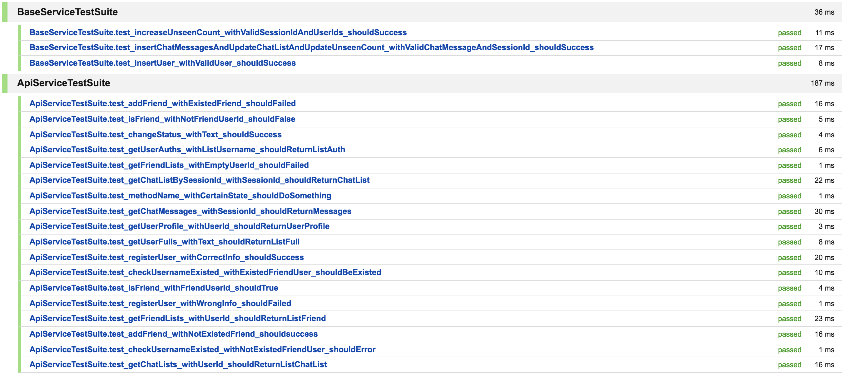
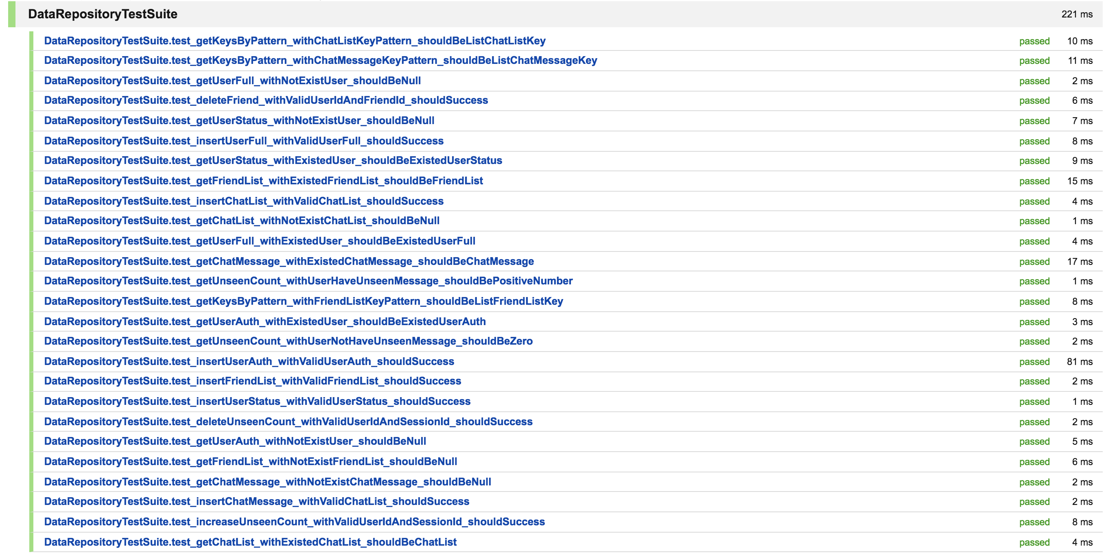
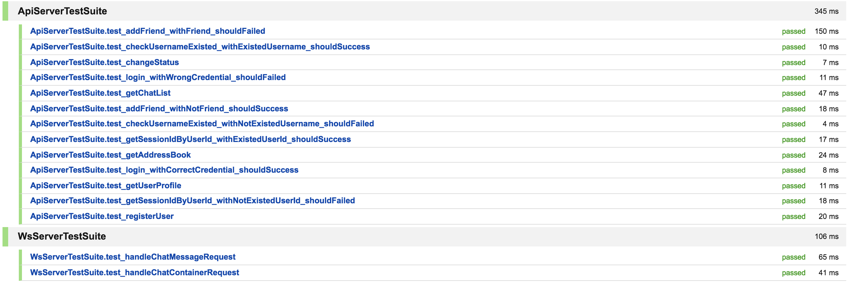
Unit Testing

Slide 24
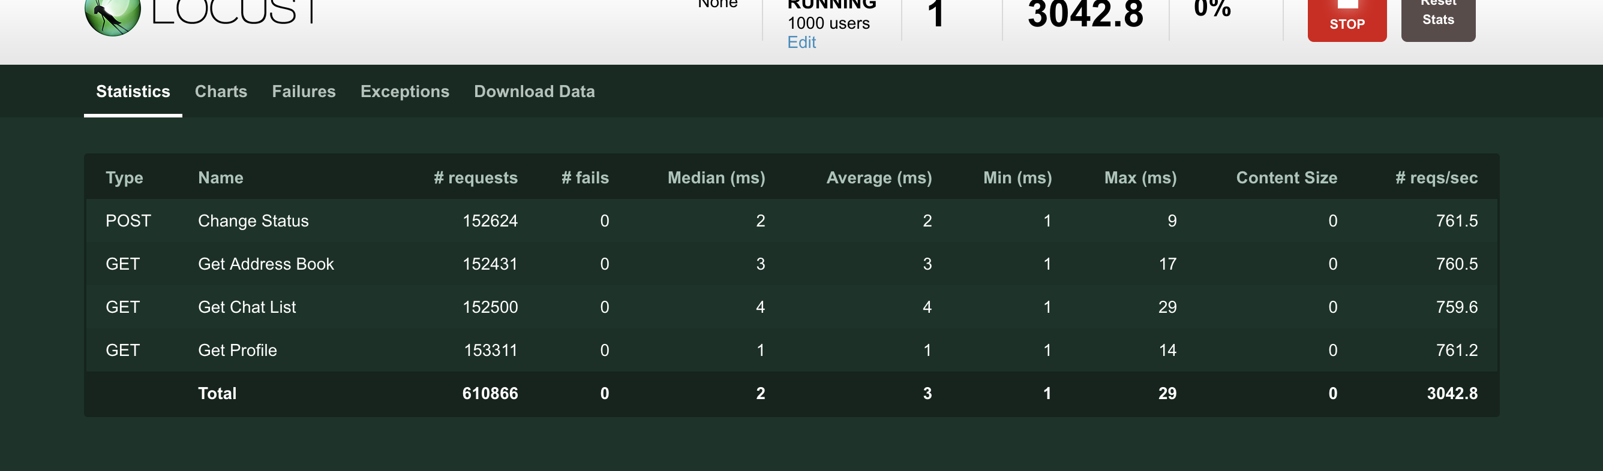
Performance Test – Common Api
Using Locust Swarm
throughput: 3000 req/s, 1000 users, total p99 = 6ms

Slide 25
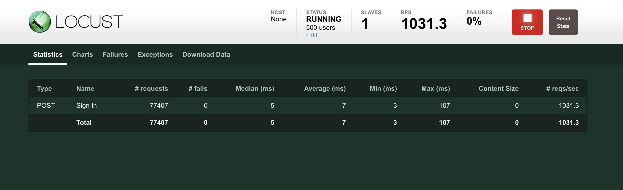
Performance Test – Login
Using Locust Swarm
throughput: 1000 req/s, 500 users, total p99 = 33ms
Comment: Since we are using BCrypt that is using SecureRandom of java, so it is understandable to exhaust more server capacity.

Slide 26
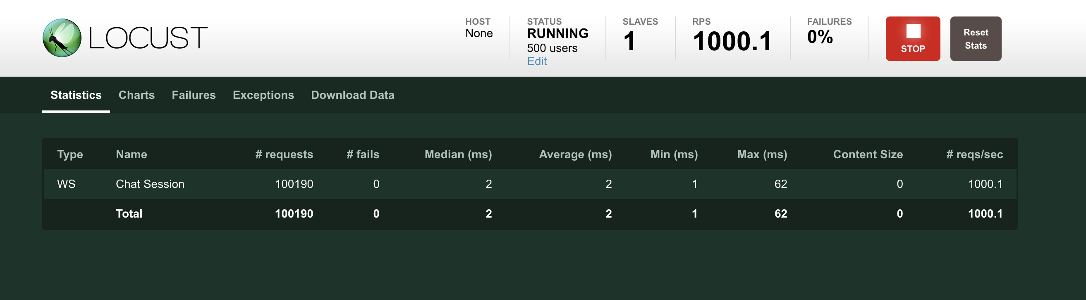
Performance Test – Websocket/ Read
Using Locust Swarm
throughput: 1000 req/s, 500 users, total p99 = 20ms
Comment: Apart from calling Api, the connection of Websocket is keeping through the test, so my computer can only open and keep up to 500 users at the same time (it hang out when I tried to increased more :( )

Slide 27

Performance Test – Websocket/ Write
Using Locust Swarm
1000 req/s, 500 users, total p99 = 2ms
Comment: Don't be surprised, as I have explained before, the connection is keeping during the work, so we don't take any time to hanshake again and again like Api calling.

Slide 28


6
QUESTION & ANSWER

Slide 29
Acknowledgement
For giving us a hand
For his extraordinary supporting HEY
MR Anh Duc Le
for his knowledge about ReactJS
Tuan
For his extensive knowledge about Vert.x and Docker
Phuong
Thank you all!
Open Sources Community

Slide 30




Contact Us!
Anywhere at Saigon
facebook.com/vcthanh24
vcthanh24
vcthanh24@mail.com

Slide 31
Thank You for Watching!

